Slide 1
Jackpot Mania
By Andrew Robertson and Orondo Jones

Slide 2

Background

Slide 3






Icons

Slide 4
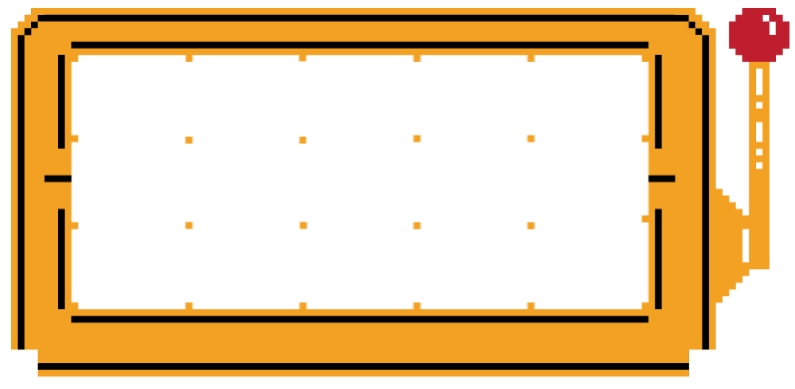
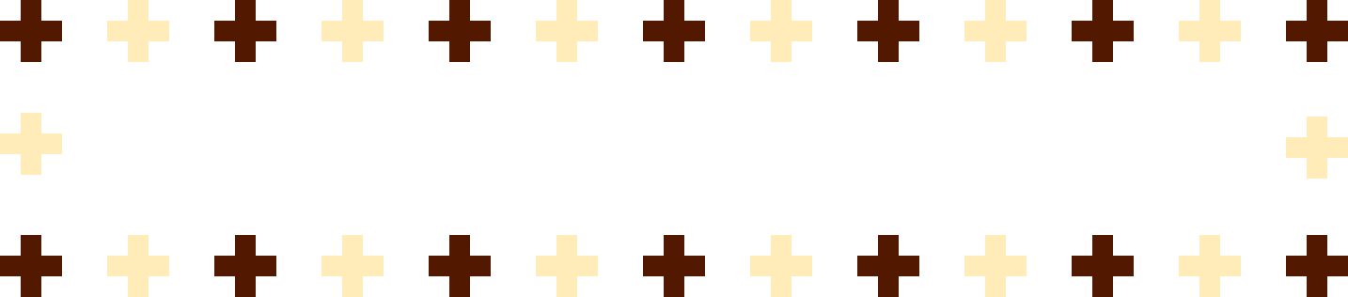
Core Images

Slide 5
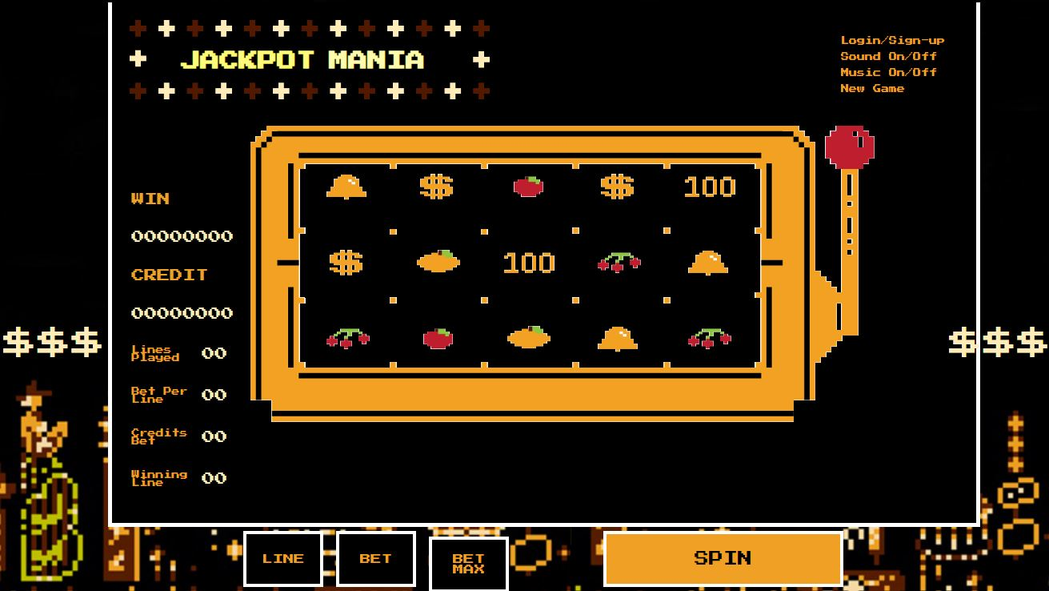
Final Product

Slide 6
The $$$ are plain text.
Right
Left
.right{
display: inline-block;
color: #FFECB9 ;
position: relative;
white-space: nowrap;
top: 0;
right: 0;
float: right;
font-size:32pt;
-webkit-animation:move 5s;
-webkit-animation-iteration-count:infinite;
-webkit-animation-delay:1s;
}
.left{
display: inline-block;
color: #FFECB9 ;
position: relative;
white-space: nowrap;
top: 0;
left: 0;
font-size:32pt;
float: left;
-webkit-animation:move 5s;
-webkit-animation-iteration-count:infinite;
-webkit-animation-delay:1s;
}

Slide 7
CSS for the $$$ cont.
Definition for position
@-webkit-keyframes move {
0% { top: 0px; }
20% { top: 100px; }
40% { top: 200px; }
60% { top: 300px; }
80% { top: 400px; }
}

Slide 8
Spinning images
.spin{
animation: icon 3s infinite;
animation-direction: normal;
}
@keyframes icon{
0% {
transform: rotateX(0);
}
100% {
transform: rotateX(360deg);
}

Slide 9
Button Effects
Line, Bet, and Bet Max Buttons
Spin Button
.btnBorder{
border: 4px #FFFFFF solid;
display: inline-block;
width:100px;
height:70px;
background-color: #000000;
color:#F0A024;
font-family: 'Press Start 2P', helvetica, sans-serif;
margin: 0px;
padding: 0px;
}
.btnBorder:hover{
background-color: #F0A024;
color: #000000;
}
.btnLrg{
font-family: 'Press Start 2P', helvetica, sans-serif;
font-size: 18px;
color:#000000;
background-color: #F0A024;
width:300px;
height: 70px;
border: 4px #ffffff solid;
margin-top: 5px;
}
.btnLrg:hover{
background-color: #000000;
color: #f0a024;
}

Slide 10
Flashing Text
#sign{
position: absolute;
font-size: 24px;
top: 45px;
left: 65px;
color:#ffffff;
animation-name: flashing;
animation-duration: 1s;
animation-delay: 1s;
animation-iteration-count: infinite;
}
@keyframes flashing{
from{color: #ffffff;}
to{color:#FFF831;}
}

Slide 11
Questions and Answers

